Slide 1
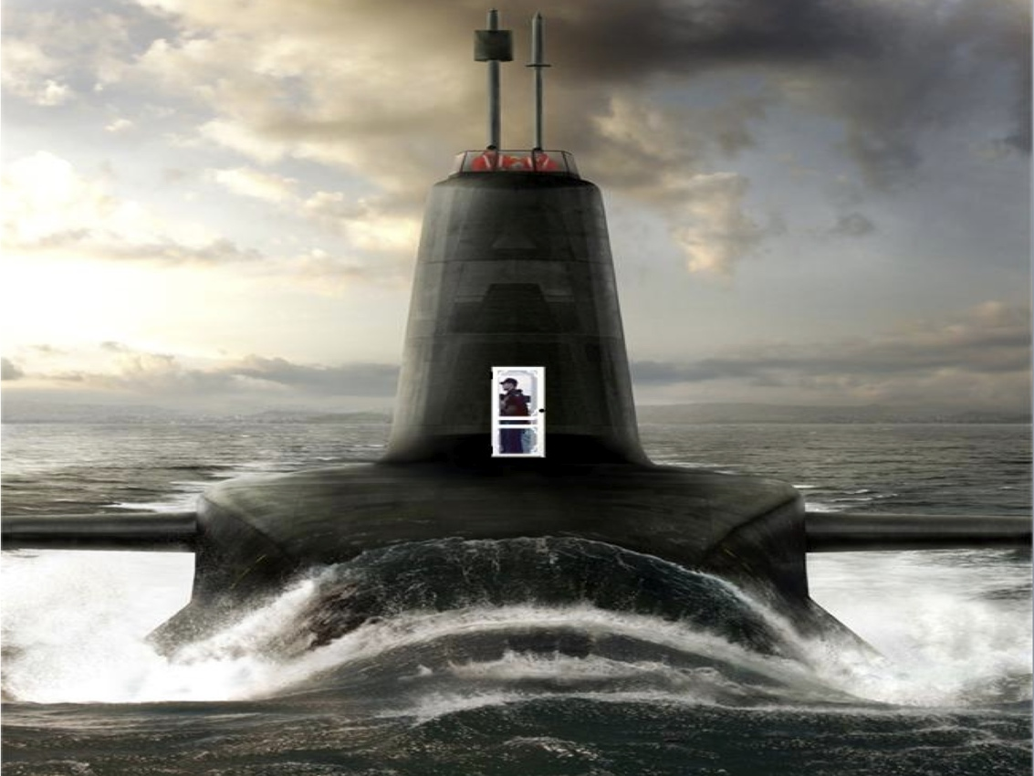
CWE version 3.0 (moving beyond software)
Robert A. Martin
Senior Principal Engineer
Cyber Security Center
Center for National Security
The MITRE Corporation
Notes:
In this presentation we will describe how Program Protection Plans, Developmental test and evaluation, Systems Engineering design & architecture reviews collective contribute to gaining assurance about DOD Software and resilience to attack.
Having assurance that the mission will not be circumvented, undermined, or unnecessarily put at risk through attacks on any software that provides critical mission capabilities requires a shift in focus and integration of many types of assessment activities across the acquisition life cycle.

Slide 2
Assurance:
Mitigating Attacks That Impact Operations
screen
door in sub
close door
sub fills
w/water
water
flooding
sub sinks
Known
Threat
Actors
Attack Patterns
(CAPECs)
Weaknesses
(CWEs)
Actions*
Technical
Impacts
Operational Impacts
System & System Security Engineering
Trades
Attack
Weakness
Item
Impact
Asset
Attack
Weakness
Item
Impact
Function
Attack
Weakness
Impact
Asset
Weakness
Item
* “Actions” include: architecture choices; design choices; added security functions, activities & processes; physical decomposition choices; static & dynamic code assessments; design reviews; dynamic testing; and pen testing

Slide 3
Assurance – Managing Weaknesses
Threat
ê
Threat Vector
ê
Weakness
ê
Manage Risk During Development
Eliminate
Mitigate
ê
ê
Vulnerability
ê
Control
ê
Implementation
ê
Test
Assess Deployment Risk
STOP
Acceptable Impact
Block from Attack
ê
ê
Alarm for Attack/Exploit
Operational Mitigation
Validate/Verify

Slide 4
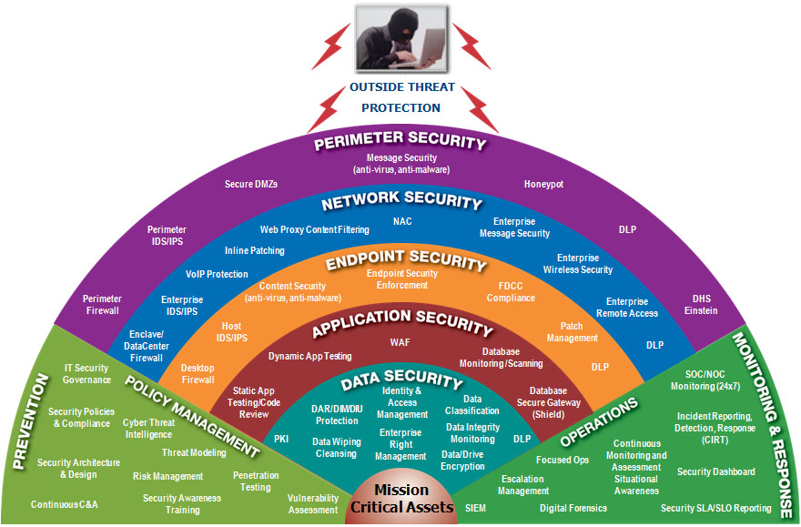

Block from Attack
Alarm for Attack/Exploit
Deny, Disrupt, Degrade,
and Deceive
Detect
Prevent
Monitor & Respond
Known Threat Actors
Mission
Critical Assets and Functions
© 2014 Northrup Grumman. All rights reserved.

Slide 5
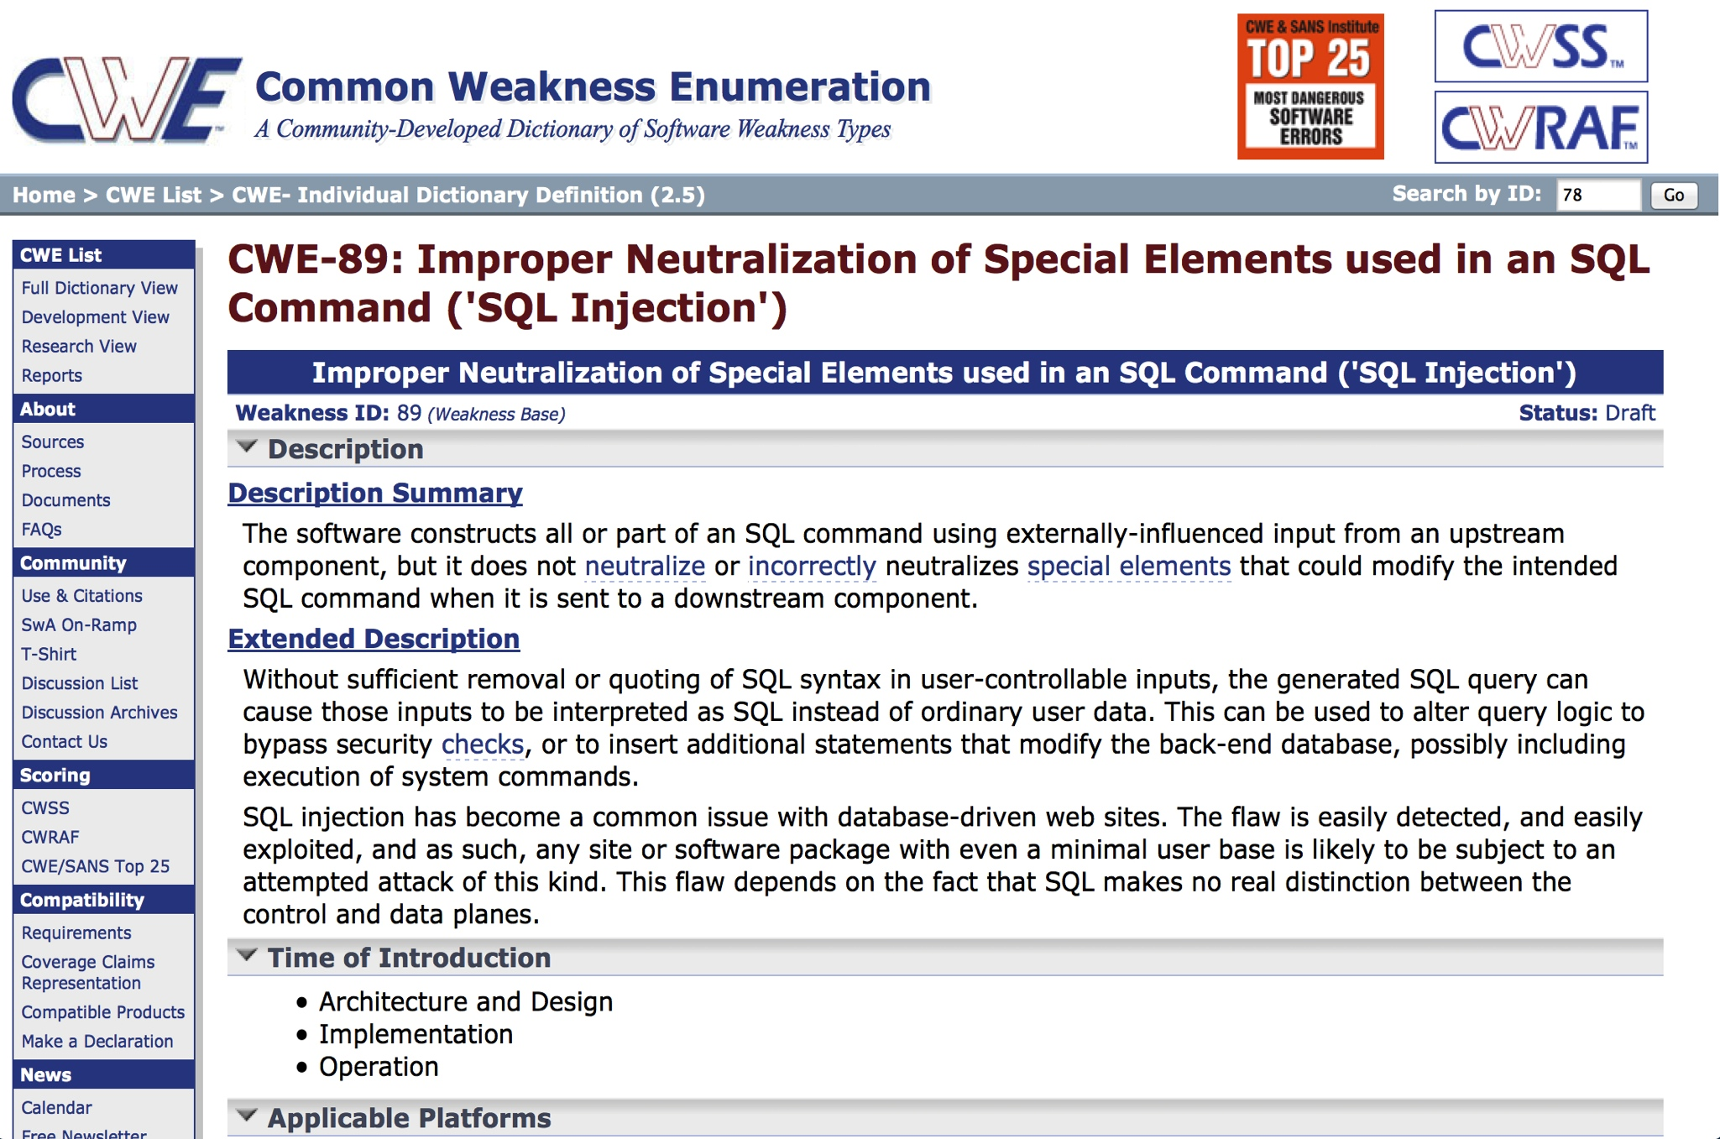
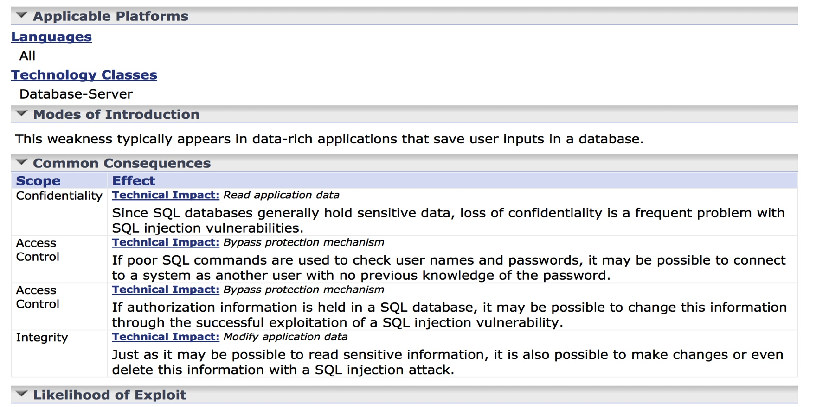
Prioritizing by Technical Impacts: CWE’s Common Consequences

Slide 6
CWE’s all lead to these Technical Impacts
Modify data
Read data
DoS: unreliable execution
DoS: resource consumption
Execute unauthorized code or commands
Gain privileges / assume identity
Bypass protection mechanism
Hide activities

Slide 7
Assurance – Mobile App Vetting:
Mitigating Attacks That Impact Operations
Attack Surface
Weaknesses in App Architecture, Design, Code, or Deployment (CWEs)
Lead to Technical Impacts
How
Read data
Modify data
Gain privileges / assume identity
Execute unauthorized code
Hide activities
Bypass protection mechanisms
DoS: unreliable execution
DoS: resource consumption
Technical Impacts
Why
Affecting
Asset & Function
Objectives
Confidentiality
Integrity
Availability
What
Organization’s
Operations
Operational Impacts
App data
User data
(PII, Location,…)
Device Capabilities
(Battery, Bandwitth, Processor, Memory, …)

Slide 8
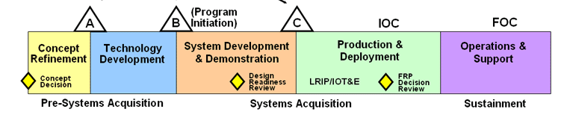
Assurance & the Systems Dev. Life-Cycle…
Abuse Case Development
Application Security Code
Review (developed and
purchased), Penetration
Testing & Abuse Case
Driven Testing
Gather All of the Evidence for the Assurance Case and Get It Approved
Cyber
Threat/
Attack
Analysis
and Systems Design
Attack Analysis against Supply Chain & Application Architecture
Security Review
Attack-based Application Design
Security Review
Application Security Code Review, Penetration Testing & Abuse Case Driven Testing of
Maintenance Updates
* Ideally Insert SwA before RFP release in Analysis of Alternatives

Slide 9
Leveraging and Managing to take Advantage of the Multiple Detection Methods
Different assessment methods are effective at finding different types of weaknesses
Some are good at finding the cause and some at finding the effect
 | Static Code Analysis | Penetration Test | Data Security Analysis | Code Review | Architecture Risk Analysis
Cross-Site Scripting (XSS) | X | X |  | X
SQL Injection | X | X |  | X
Insufficient Authorization Controls |  | X | X | X | X
Broken Authentication and Session Management |  | X | X | X | X
Information Leakage |  | X | X |  | X
Improper Error Handling | X
Insecure Use of Cryptography |  | X |  | X | X
Cross Site Request Forgery (CSRF) |  | X |  | X
Denial of Service | X | X | X |  | X
Poor Coding Practices | X |  |  | X

Slide 10


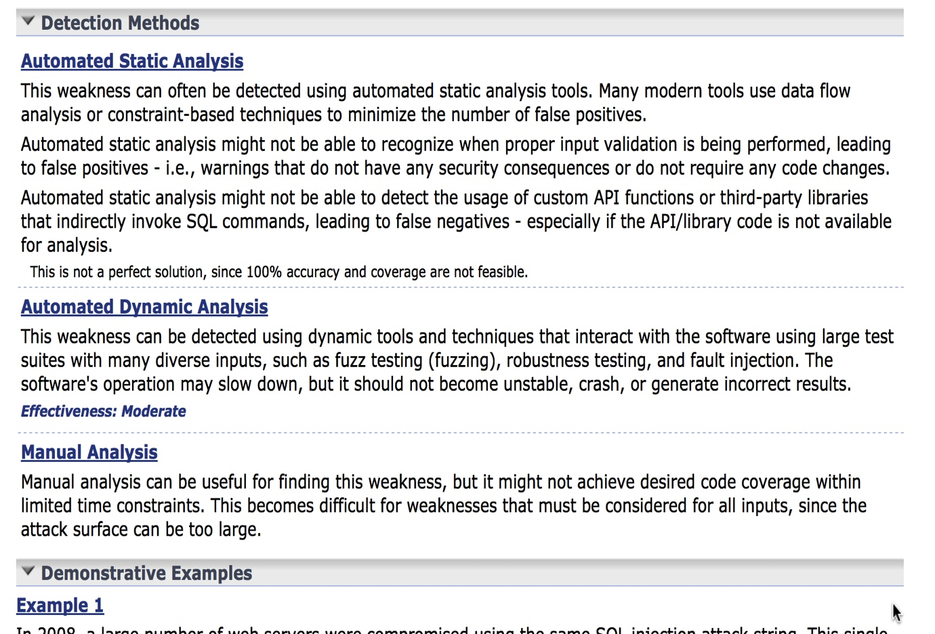
Technical Impacts – Common Consequences
Detection Methods

Slide 11
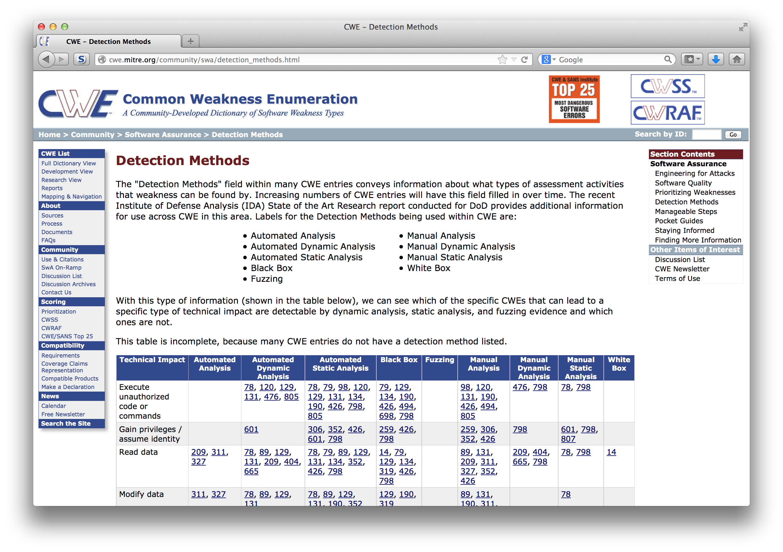
New Detection Methods Launched Feb 17

Slide 12
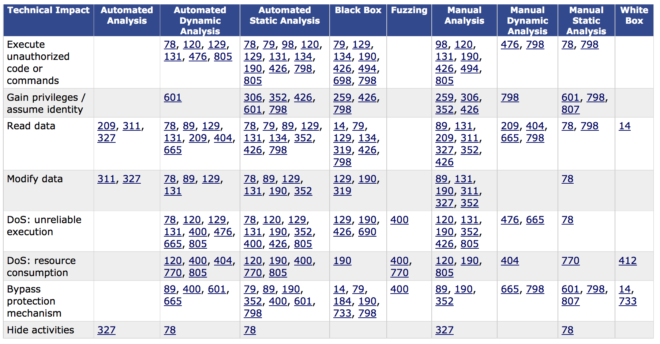

Slide 13
Utilizing a Priority List of Weaknesses
Code Review
CWEs a capability claims to cover
Static Analysis Tool A
Most Important Weaknesses
(CWEs)
Static Analysis Tool B
Pen Testing Services
Which static analysis tools and Pen Testing services find the CWEs I care about?

Slide 14
Assurance:
Mitigating Attacks That Impact Operations
Known
Threat
Actors
Attack Patterns
(CAPECs)
Weaknesses
(CWEs)
Actions*
Technical
Impacts
Operational Impacts
System & System Security Engineering
Trades
Attack
Weakness
Item
Impact
Asset
Attack
Weakness
Item
Impact
Function
Attack
Weakness
Impact
Asset
Weakness
Item
* “Actions” include: architecture choices; design choices; added security functions, activities & processes; physical decomposition choices; static & dynamic code assessments; design reviews; dynamic testing; and pen testing

Slide 15
Assurance on the Management of Weaknesses
CWE
CVE
Threat
ê
Threat Vector
ê
Weakness
ê
Vulnerability
ê
Control
ê
Implementation
ê
Test
CAPEC
Manage Risk During Development
Eliminate
Mitigate
ê
ê
Assess Deployment Risk
Block from Attack
ê
ê
Alarm for Attack/Exploit
Operational Mitigation
Validate/Verify

Slide 16

Attacks & Hazards
Mission
Fulfillment
Mission
Weakness #1
Capability
Mission Fulfillment
Weakness #2
Mission
Fulfillment
Weakness #3

Slide 17
Attacks & Hazards
Impact from
Weakness #1
Mission
Fulfillment
Mission
Exploitable Weakness #1 (a vulnerability)
Capability
Mission Fulfillment
Exploitable Weakness #2 (a vulnerability)
Mission
Fulfillment
Weakness #3
Impact from
Weakness #3

Slide 18
Many Capabilities Support the Mission
Capability
Capability
Capability
Capability
Hardware
Capability
Software
Processes
Hardware?
Parts
Units
Sub-Assemble
People
Supply Chain Activities

Slide 19
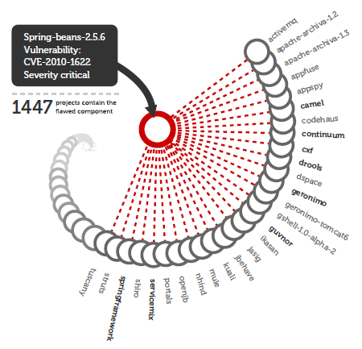
CWE-937
Even after vulnerabilities are discovered and patches made available, many developers use (or continue to ues) the flawed, non-patched version of reused components
Source: Maximizing Benefits and Mitigating Risks of Open Source Components in Application Development, by Sonatype

Slide 20
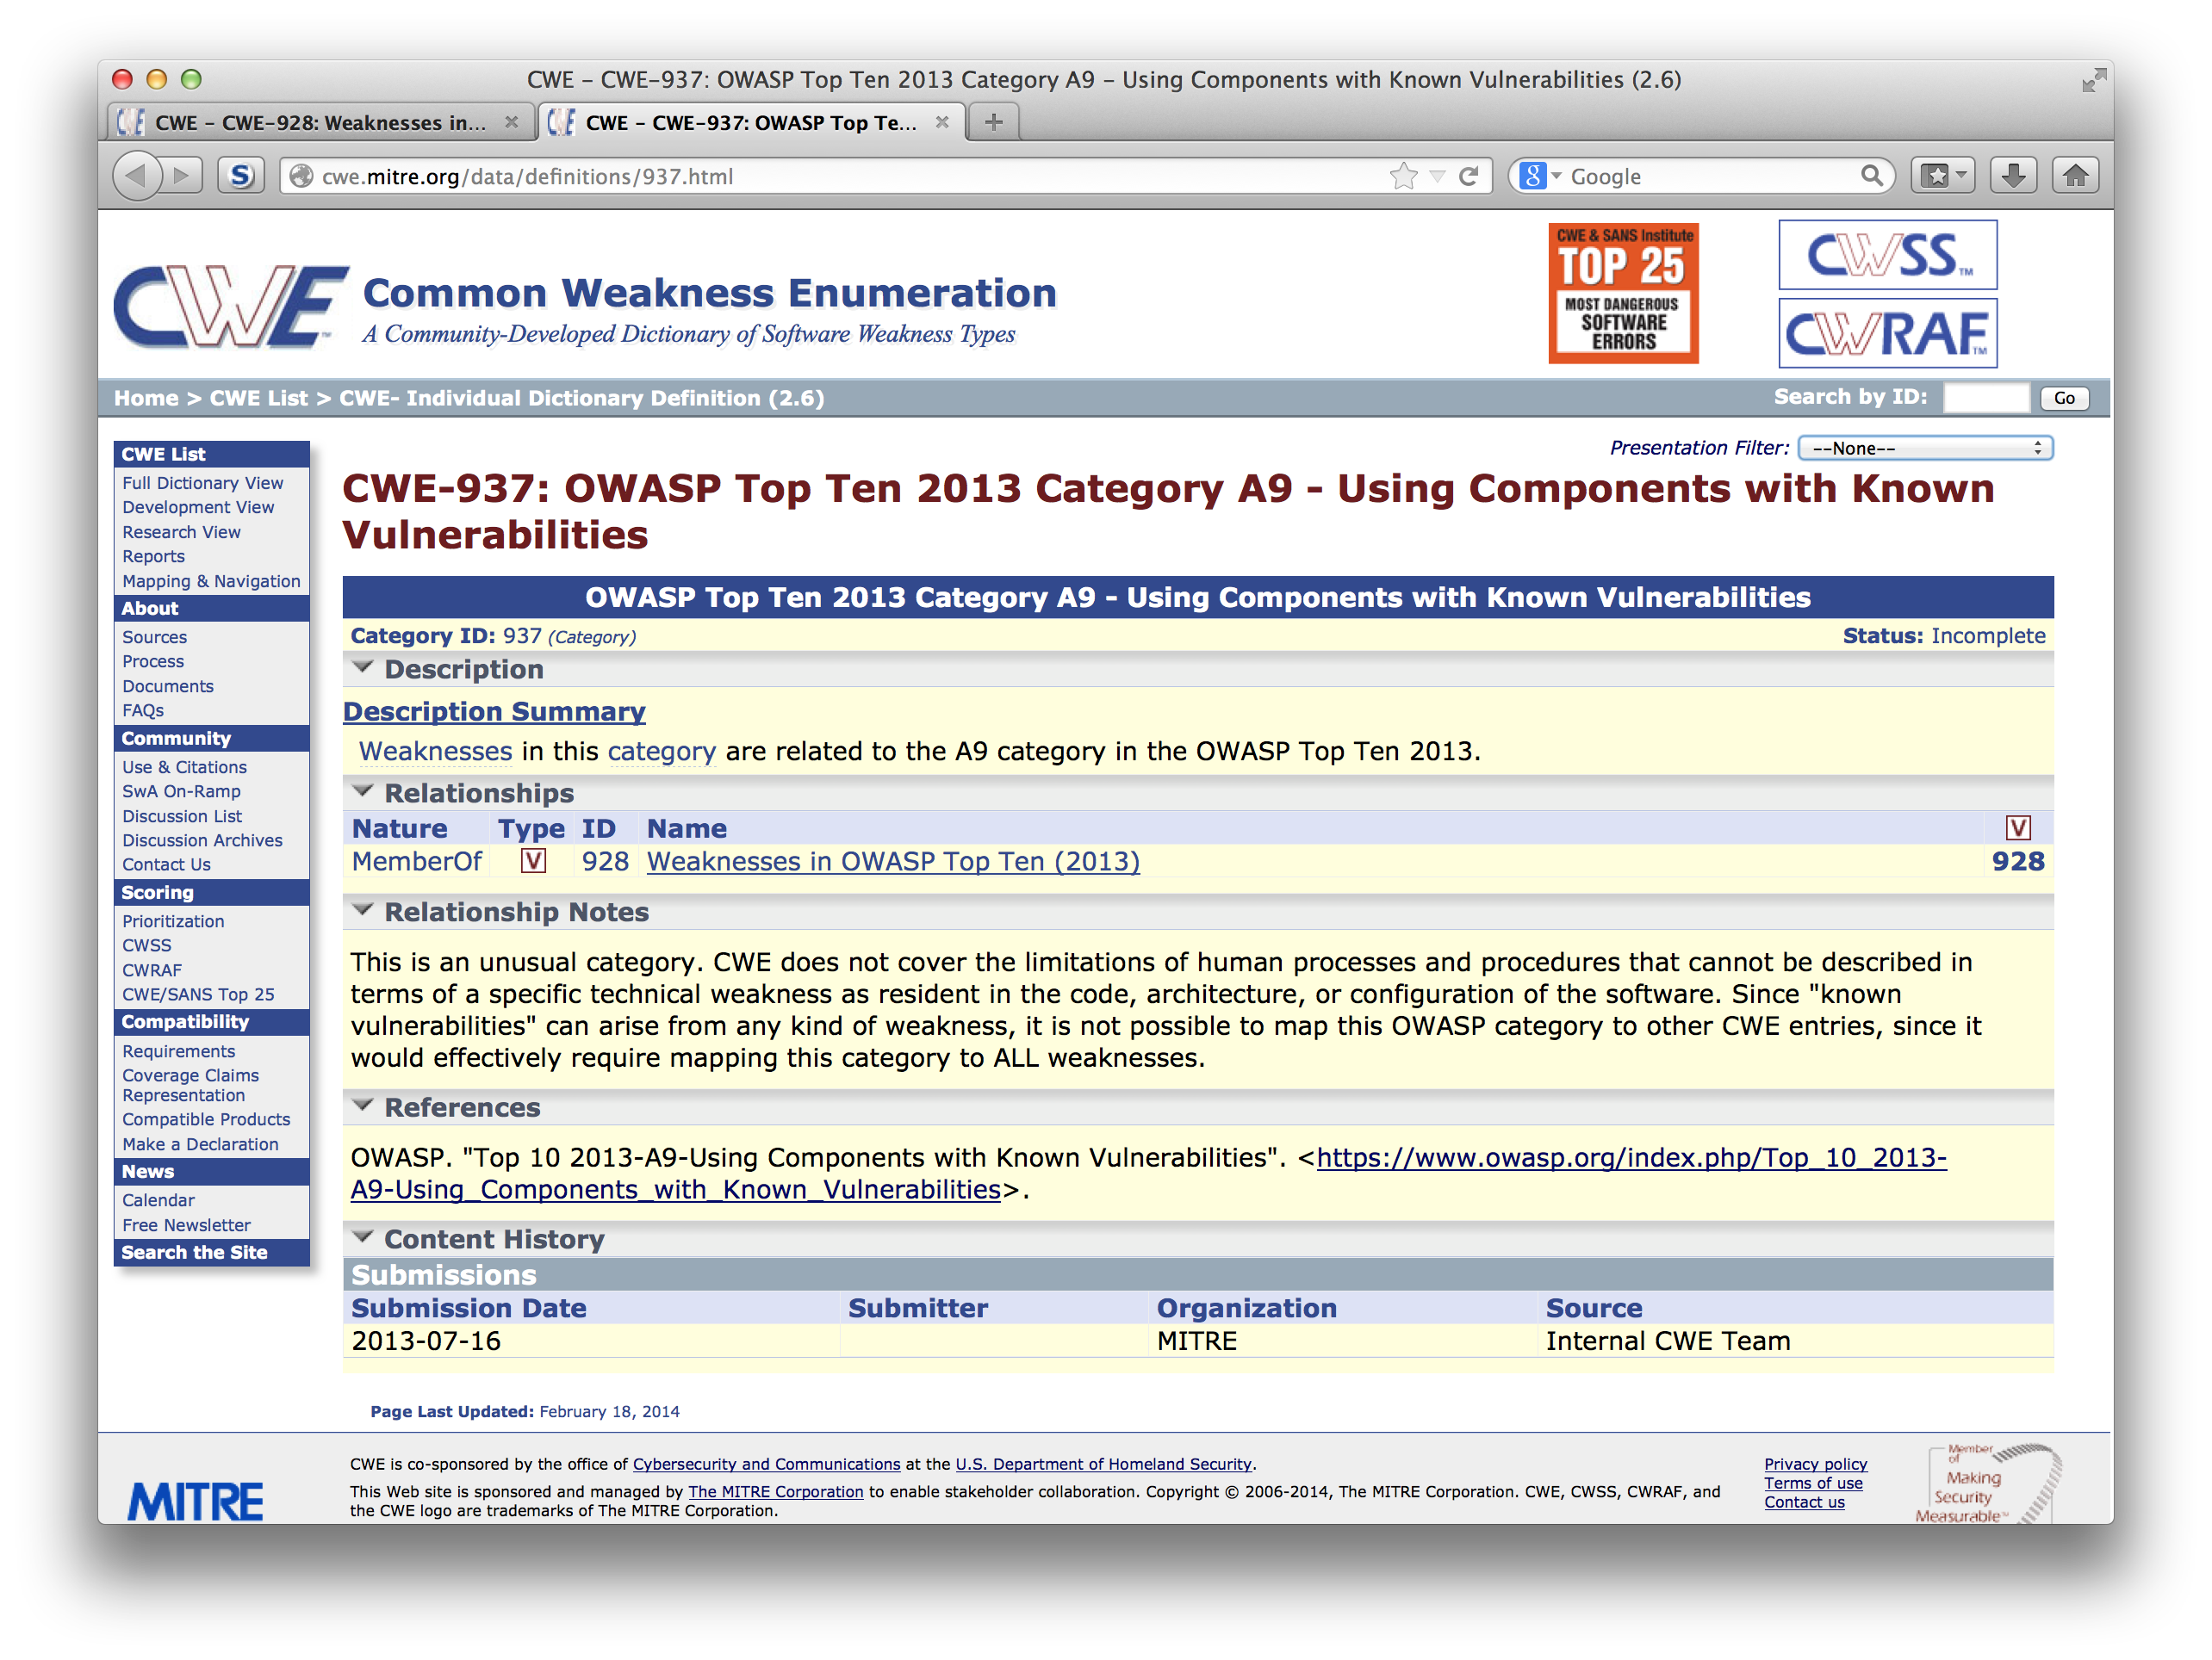

Slide 21
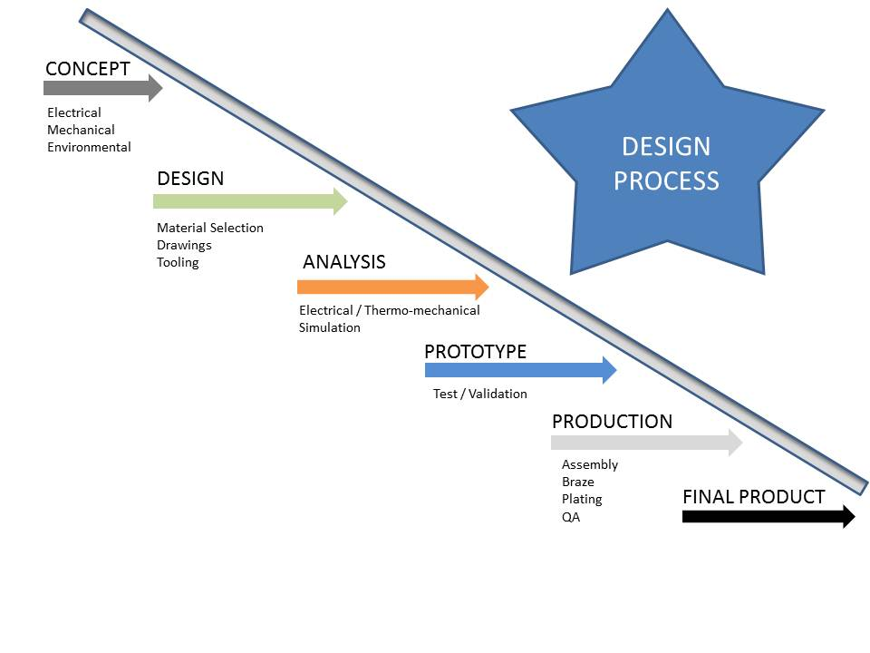

Slide 24
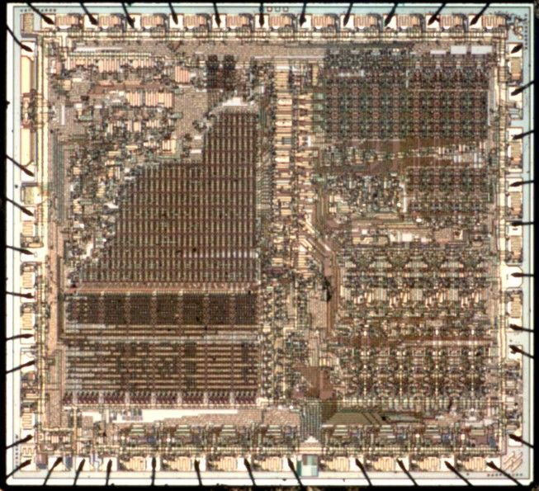
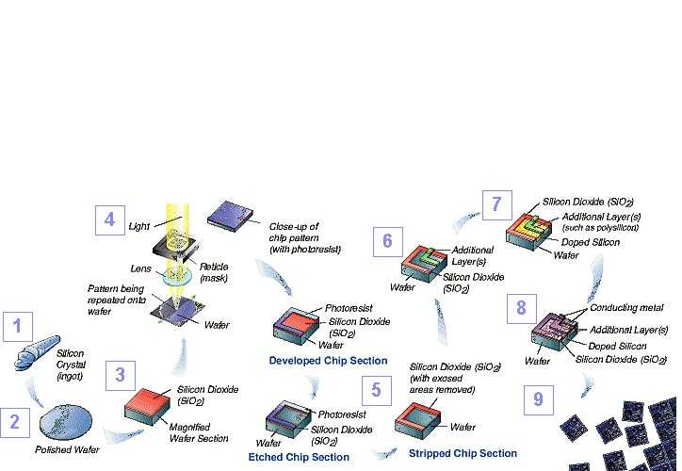
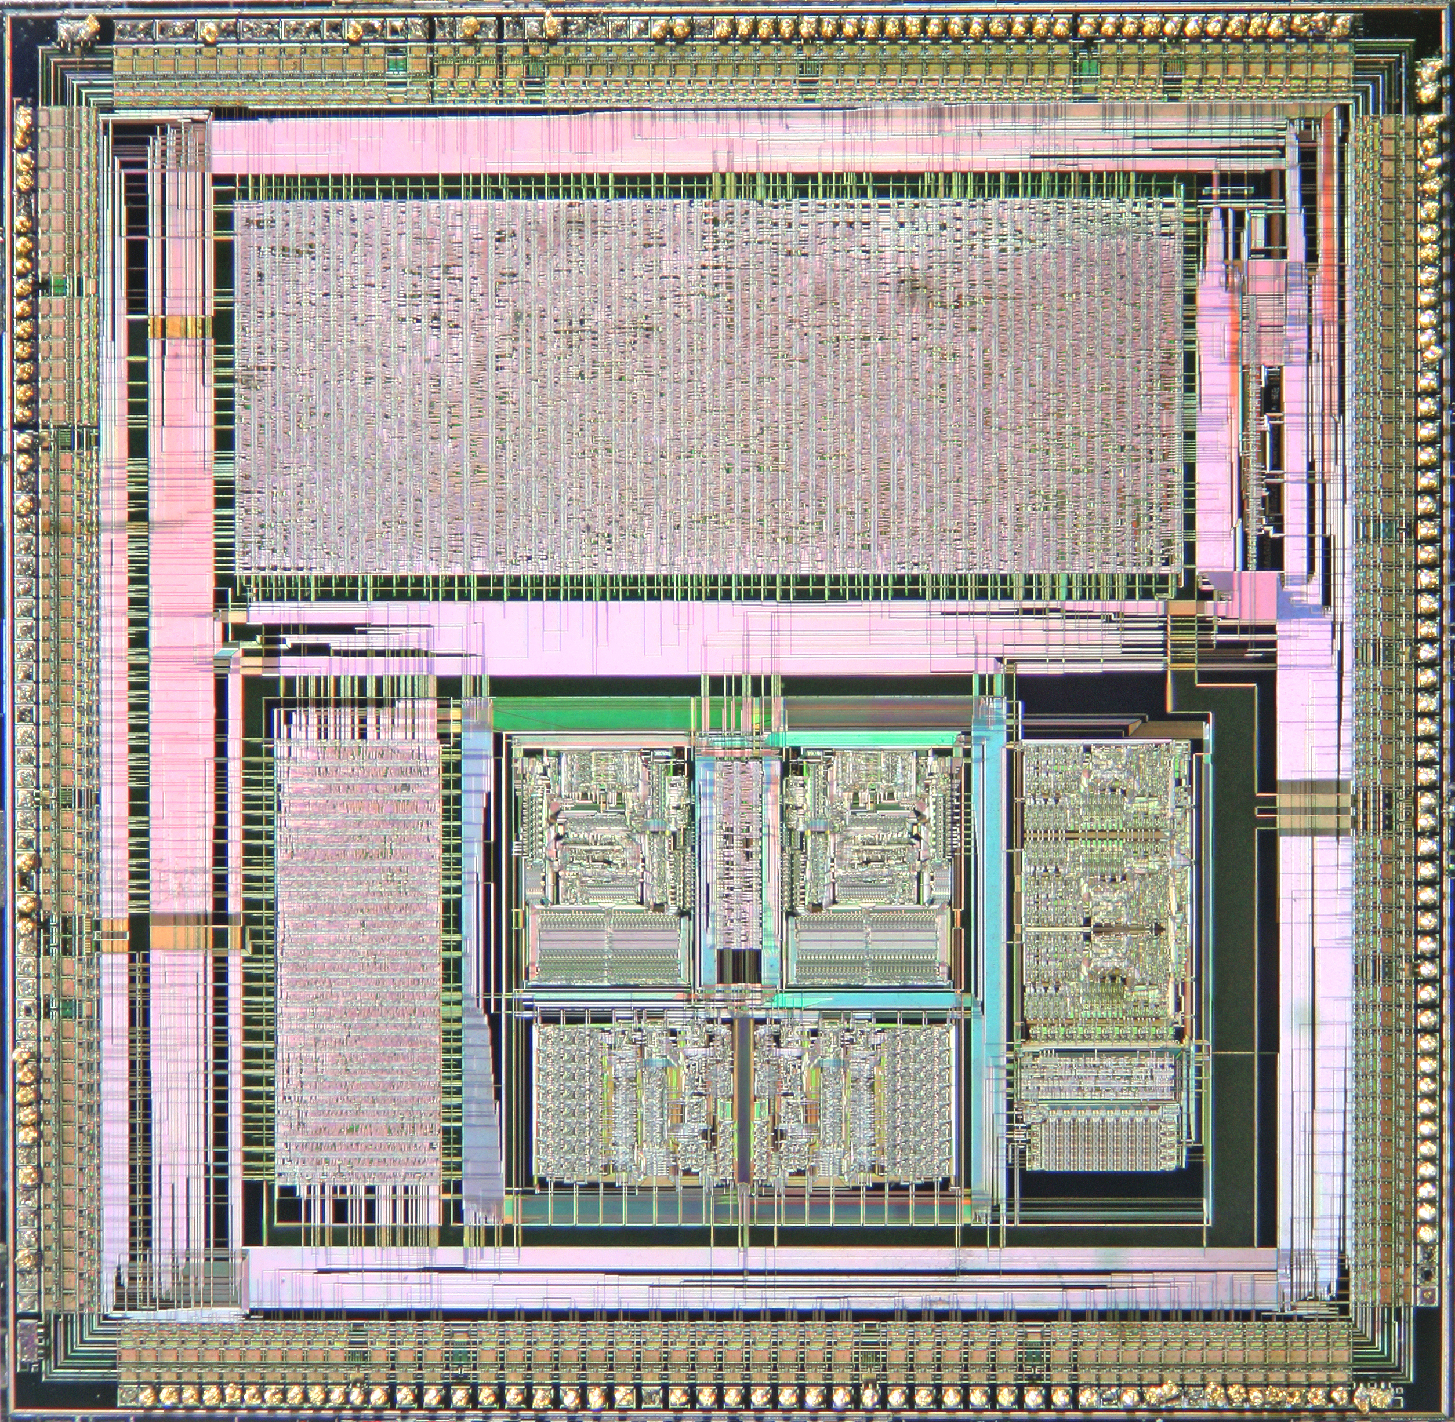
ASICs and FPGAs

